Slide 1
Chapter 16
Multiple Regression and Correlation
to accompany
Introduction to Business Statistics
seventh edition, by Ronald M. Weiers
Presentation by Priscilla Chaffe-Stengel
Donald N. Stengel
© 2011 Cenage Learning.
All Rights Reserved. May not be scanned, copied, or duplicated, or posted to a publicly accessible website, in whole or in part.

Slide 2
Chapter 16 Learning Objectives
Obtain and interpret the multiple regression equation
Make estimates using the regression model:
  Point value of the dependent variable, y
  Intervals:
    Confidence interval for the conditional mean of y
    Prediction interval for an individual y observation
Conduct and interpret hypothesis tests on the
  Coefficient of multiple determination
  Partial regression coefficients
© 2011 Cengage Learning.
All Rights Reserved. May not be scanned, copied, or duplicated, or posted to a publicly accessible website, in whole or in part.

Slide 3
Chapter 16 - Key Terms
Partial regression coefficients
Multiple standard error of the estimate
Conditional mean of y
Individual y observation
Coefficient of multiple determination
Coefficient of partial determination
Global F-test
Standard deviation of b_{i}
© 2011 Cengage Learning.
All Rights Reserved. May not be scanned, copied, or duplicated, or posted to a publicly accessible website, in whole or in part.

Slide 4
The Multiple Regression Model
Probabilistic Model
y_{i} = β₀ + β₁x_{1i} + β₂x_{2i} + ... + β_{k}x_{ki} + ε_{i}
where y_{i} = a value of the dependent variable, y
β₀ = the y-intercept
x_{1i}, x_{2i}, ... , x_{ki} = individual values of the independent variables, x₁, x₂, ... , x_{k}
β₁, β₂ ,... , β_{k} = the partial regression coefficients for the independent variables, x₁, x₂, ... , x_{k}
ε_{i} = random error, the residual
© 2011 Cengage Learning.
All Rights Reserved. May not be scanned, copied, or duplicated, or posted to a publicly accessible website, in whole or in part.

Slide 5
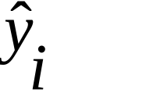
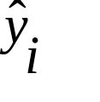
The Multiple Regression Model
Sample Regression Equation
= b₀ + b₁x_{1i} + b₂x_{2i} + ... + b_{k}x_{ki}
where = the predicted value of the dependent variable, y, given the values of x₁, x₂, ... , x_{k}
b₀ = the y-intercept
x_{1i}, x_{2i}, ... , x_{ki} = individual values of the independent variables, x₁, x₂, ... , x_{k}
b₁, b₂, ... , b_{k} = the partial regression coefficients for the independent variables, x₁, x₂, ... , x_{k}
© 2011 Cengage Learning.
All Rights Reserved. May not be scanned, copied, or duplicated, or posted to a publicly accessible website, in whole or in part.

Slide 6
Multiple Regression Example
Problem 16.11: The owner of a large chain of health spas has selected eight of her smaller clubs for a test in which she varies the size of the newspaper ad and the amount of the initiation fee discount to see how this might affect the number of prospective members who visit each club during the following week. The results are shown on the next slide.
© 2011 Cengage Learning.
All Rights Reserved. May not be scanned, copied, or duplicated, or posted to a publicly accessible website, in whole or in part.

Slide 7
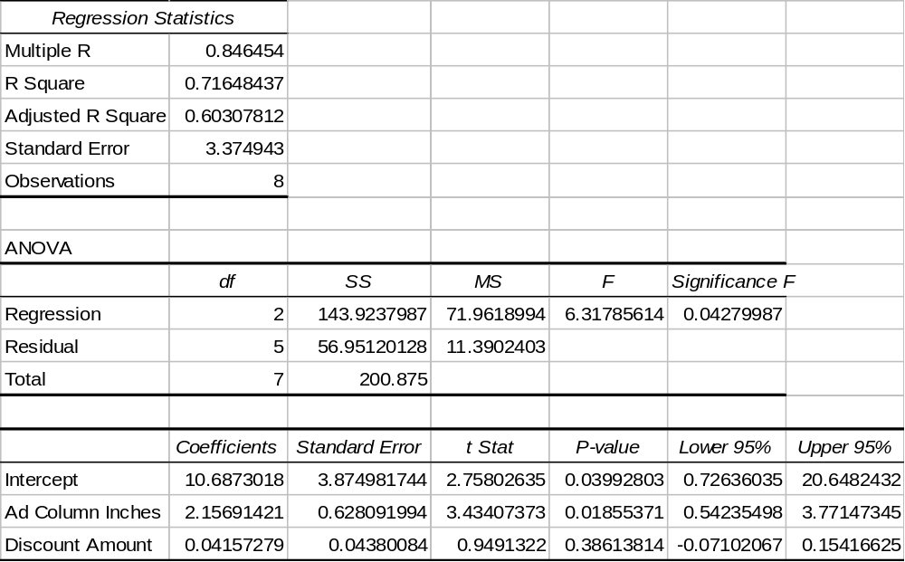
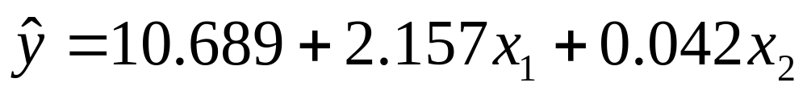
Problem 16.11, cont.
Using Excel output:
a. the regression equation:
© 2011 Cengage Learning.
All Rights Reserved. May not be scanned, copied, or duplicated, or posted to a publicly accessible website, in whole or in part.

Slide 8
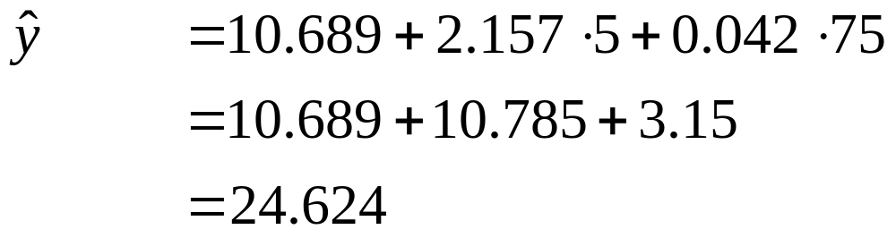
Problem 16.11, cont.
b. Interpreting the regression coefficients:
  For each column-inch of ad she buys, she can expect an average of 2.157 new members.
  For each hundred dollars she allows in membership discount, she can expect an average of 4.2 new members.
c. If the ad is 5 column-inches and offers $75 discount, she can expect nearly 25 new members.
© 2011 Cengage Learning.
All Rights Reserved. May not be scanned, copied, or duplicated, or posted to a publicly accessible website, in whole or in part.

Slide 9

The Amount of Scatter in the Data
The multiple standard error of the estimate
where y_{i} = each observed value of y in the data set
= the value of y that would have been estimated from the regression equation
n = the number of data values in the set
k = the number of independent (x) variables
measures the dispersion of the data points around the regression hyperplane.
y
ˆ
2
∑
(
–
y
)
s
=
i
i
e
n
–
k
–
1
© 2011 Cengage Learning.
All Rights Reserved. May not be scanned, copied, or duplicated, or posted to a publicly accessible website, in whole or in part.

Slide 10

Approximating a Confidence Interval for a Mean of y
A reasonable estimate for interval bounds on the conditional mean of y given various x values is generated by:
where = the estimated value of y based on the set of x values provided
t = critical t value, (1–α)% confidence, df = n – k – 1
s_{e} = the multiple standard error of the estimate
s
ˆ
±
⋅
e
y
t
n
© 2011 Cengage Learning.
All Rights Reserved. May not be scanned, copied, or duplicated, or posted to a publicly accessible website, in whole or in part.

Slide 11
Approximating a Prediction Interval for an Individual y Value
A reasonable estimate for interval bounds on an individual y value given various x values is generated by:
where = the estimated value of y based on the set of x values provided
t = critical t value, (1–α)% confidence, df = n – k – 1
s_{e} = the multiple standard error of the estimate
ˆ
y
±
t
⋅
s
e
© 2011 Cengage Learning.
All Rights Reserved. May not be scanned, copied, or duplicated, or posted to a publicly accessible website, in whole or in part.

Slide 12
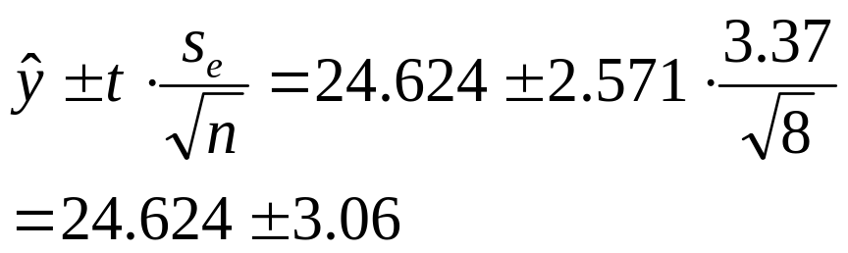
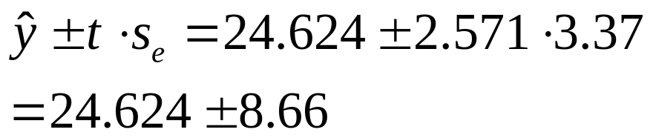
Interval Estimates, An Example
A reasonable estimate for the average number of new health spa members that can be expected from all ads with 5 column-inches offering $75 membership discount with 95% confidence:
A reasonable estimate on the number of new health spa members that can be expected from an individual ad with 5 column-inches offering $75 membership discount with 95% confidence:
© 2011 Cengage Learning.
All Rights Reserved. May not be scanned, copied, or duplicated, or posted to a publicly accessible website, in whole or in part.

Slide 13
Coefficient of Multiple Determination
The proportion of variance in y that is explained by the multiple regression equation is given by:
2
y
ˆ
Σ
(
–
y
)
2
i
i
SSE
SSR
R
=
1
–
=
1
–
=
2
SST
SST
(
y
–
y
Σ
)
i
© 2011 Cengage Learning.
All Rights Reserved. May not be scanned, copied, or duplicated, or posted to a publicly accessible website, in whole or in part.

Slide 14
Coefficients of Partial Determination
For each independent variable, the coefficient of partial determination denotes the proportion of total variation in y that is explained by that one independent variable alone, holding the values of all other independent variables constant. The coefficients are reported on computer printouts.
© 2011 Cengage Learning.
All Rights Reserved. May not be scanned, copied, or duplicated, or posted to a publicly accessible website, in whole or in part.

Slide 15
Testing the Overall Significance of the Multiple Regression Model
Is using the regression equation to predict y better than using the mean of y?
The Global F-Test
I. H₀: β₁ = β₂ = ... = β_{k} = 0
The mean of y is doing as good a job at predicting the actual values of y as the regression equation.
H₁: At least one β_{i} does not equal 0.
The regression model is doing a better job of predicting actual values of y than using the mean of y.
© 2011 Cengage Learning.
All Rights Reserved. May not be scanned, copied, or duplicated, or posted to a publicly accessible website, in whole or in part.

Slide 16
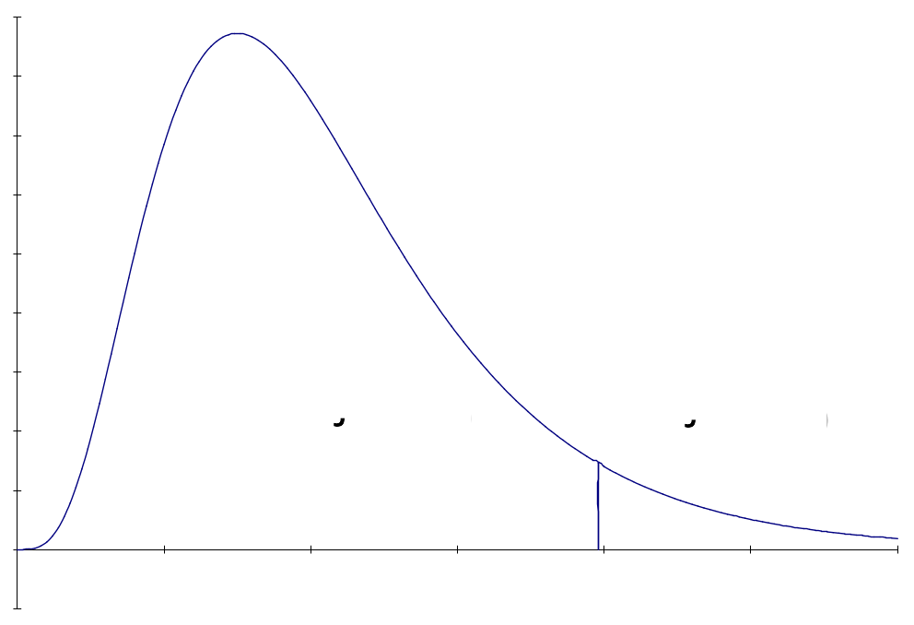
Testing Model Significance
II. Rejection Region
Given α and
numerator df = k, denominator df = n – k – 1
Decision Rule: If F > critical value, reject H₀.
© 2011 Cengage Learning.
All Rights Reserved. May not be scanned, copied, or duplicated, or posted to a publicly accessible website, in whole or in part.

Slide 17
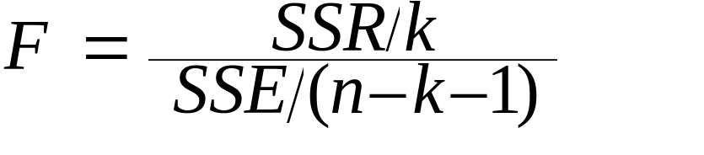
Testing Model Significance
III. Test Statistic
where SSR = SST – SSE
SST =
SSE =
If H₀ is rejected:
• At least one β_{i} differs from zero.
•The regression equation does a better job of predicting
the actual values of y than using the mean of y.
(
y
–
y
2
Σ
)
i
y
ˆ
2
(
–
y
Σ
)
i
© 2011 Cengage Learning.
All Rights Reserved. May not be scanned, copied, or duplicated, or posted to a publicly accessible website, in whole or in part.

Slide 18
Testing the Overall Significance: An Example
Is using the regression equation to predict y better than using the mean of y?
The Global F-Test
I. H₀: β₁ = β₂ = 0
The mean of y is doing as good a job at predicting the actual values of y as the regression equation.
H₁: At least one β_{i} does not equal 0.
The regression model is doing a better job of predicting actual values of y than using the mean of y.
© 2011 Cengage Learning.
All Rights Reserved. May not be scanned, copied, or duplicated, or posted to a publicly accessible website, in whole or in part.

Slide 19
Testing Model Significance:
An Example
II. Rejection Region
Given α = .05 and
numerator df = 2, denominator df = 5
Decision Rule: If F > 5.79, reject H₀.
5.79
© 2011 Cengage Learning.
All Rights Reserved. May not be scanned, copied, or duplicated, or posted to a publicly accessible website, in whole or in part.

Slide 20
Testing Model Significance:
An Example
III. Test Statistic
F = 6.318
IV. Conclusion: Since the test statistic of F = 6.318 falls above the critical bound of F = 5.79, we reject H₀ with at least 95% confidence.
V. Implications: There is enough evidence to conclude that the regression model does a better job of predicting the number of new members resulting from an ad than using the average number of new members to the health spa.
© 2011 Cengage Learning.
All Rights Reserved. May not be scanned, copied, or duplicated, or posted to a publicly accessible website, in whole or in part.

Slide 21
Testing the Significance of a Single Regression Coefficient
Is the independent variable x_{i} useful in predicting the actual values of y?
The Individual t-Test
I. H₀: β_{i} = 0
The dependent variable (y) does not depend on values of the independent variable x_{i}. (This can, with good reason, be structured as a one-tail test instead.)
H₁: β_{i} ≠ 0
The dependent variable (y) does change with the values of the independent variable x_{i}.
© 2011 Cengage Learning.
All Rights Reserved. May not be scanned, copied, or duplicated, or posted to a publicly accessible website, in whole or in part.

Slide 22
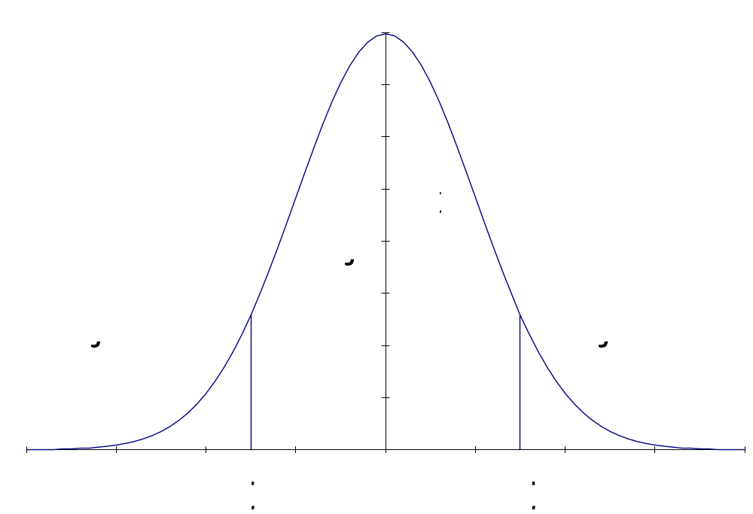
Testing the Impact on y of a Single Independent Variable
II. Rejection Region
Given α and df = n – k – 1
Decision Rule:
If t > critical value
or t < critical value,
reject H₀.
© 2011 Cengage Learning.
All Rights Reserved. May not be scanned, copied, or duplicated, or posted to a publicly accessible website, in whole or in part.

Slide 23
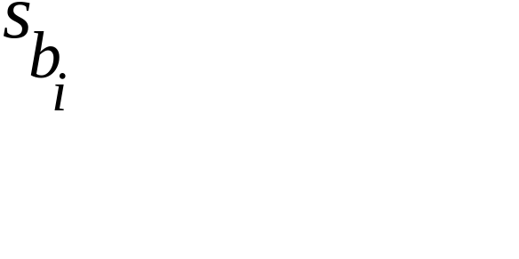
Testing the Impact on y of a Single Independent Variable
III. Test Statistic
where b_{i} = estimate for β_{i} for the multiple regression equation
= the standard deviation of b_{i}
If H₀ is rejected:
• The dependent variable (y) does change with the independent variable (x_{i}).
b
–
0
t
=
i
s
b
i
© 2011 Cengage Learning.
All Rights Reserved. May not be scanned, copied, or duplicated, or posted to a publicly accessible website, in whole or in part.

Slide 24
Testing Individual Coefficients:
An Example
Ad column-inches: t_{crit} = 2.571, t_{calc} = 3.434 Conclusion: Reject H₀. The variable is useful at the .05 level in predicting the number of new members.
Discount amount: t_{crit} = 2.571, t_{calc} = 0.949 Conclusion: Do not reject H₀. The variable is not useful at the .05 level in predicting the number of new members.
© 2011 Cengage Learning.
All Rights Reserved. May not be scanned, copied, or duplicated, or posted to a publicly accessible website, in whole or in part.

